Slide 1
DSE CL557 - Artificial & Computational Intelligence #2 : Rational Agents and Environments
Dr Jyotsana Grover
WILP

Slide 2
Learning Objectives
After this session, you will be able to :
Understand the concept of artificial intelligent agent
Understand the basic concept of rationality
Interpret and apply fundamental of type of agent on current problems
related to artificial intelligence.

Slide 3
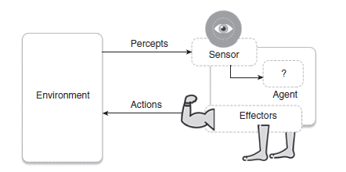
Agents
An agent is anything that can be viewed as perceiving its environment through sensors and acting upon that environment through actuators

Slide 4
Agents
The complete set of inputs at a given time is called a percept.
The current percept, or a sequence of percepts can influence the actions of an agent.
The agent can change the environment through actuators or effectors.
An operation involving an effector is called an action.
The agent can have goals which it tries to achieve.
Thus, an agent can be looked upon as a system that implements a mapping from
percept sequences to actions.

Slide 5
Agent Performance
An agent function implements a mapping from perception history to action.
The performance of intelligent agents have to be evaluated in terms of the agent function.
The ideal mapping specifies which actions an agent ought to take at any point in
time.
The performance measure is a subjective measure to characterize how successful an
agent is.
The success can be measured in various ways.
It can be measured in terms of speed or efficiency of the agent or the accuracy or the
quality of the solutions achieved by the agent.

Slide 6
Examples
Humans can be looked upon as agents. They have eyes, ears, skin, taste buds, etc. for sensors; and hands, fingers, legs, mouth for effectors.
Robots are agents. Robots may have camera, sonar, infrared, bumper, etc. for
sensors. They can have grippers, wheels, lights, speakers, etc. for actuators. Some examples of robots are Xavier from CMU.
Expert Systems: Cardiologist
Intelligent buildings

Slide 7
Agent Faculties
The fundamental faculties of intelligence are
Acting
Sensing
Understanding, reasoning, learning

Slide 8
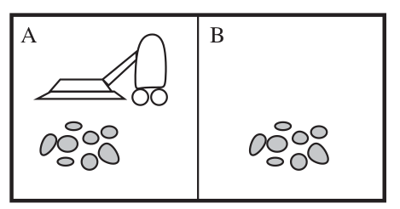
A simple agent: Vacuum cleaner
Simple vacuum cleaner agent
The vacuum agent perceives in which square it is in and if there is dirt in the square. It may choose to move left, right or suck up the dirt or do nothing. On the basis of the aforementioned task, one of the very simple functions of the agent is the following: If the current square is dirty then suck, otherwise move to other square. Hence, we can write:
Precepts: location and status, e.g., [A, Dirty]
Actions: left, right, suck and no-op (Do Nothing)

Slide 9
Vacuum cleaner problem
Performance measure of vacuum cleaner agent: All the rooms are well cleaned.
Behaviour/action of agent: Left, right, suck and no-op (Doing nothing).
Percept: Location and status, for example, [A, Dirty].
Agent function: Mapping of precept sequence to an action

Slide 10
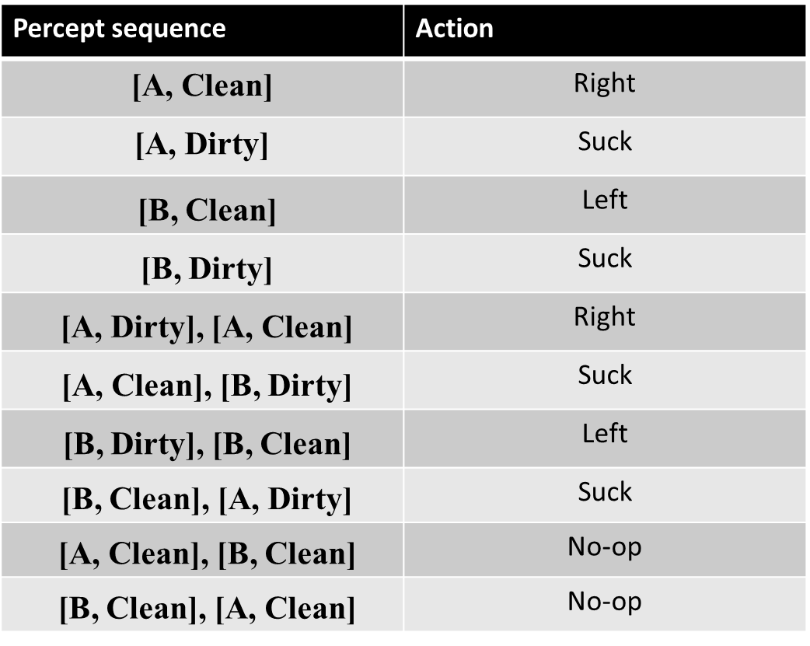
Vacuum cleaner problem

Slide 11
Intelligent Agents
An Intelligent Agent must sense, must act, must be autonomous (to some extent). It also must be rational (ideal).
AI is about building rational agents. An agent is something that perceives and acts. A rational agent always does the right thing.
While designing the intelligent systems, there are following four main factors to be
considered
P, Percepts: The inputs to the AI system.
A, Actions: The outputs of the AI system.
G, Goals: What the agent is expected to achieve.
E, Environment: What the agent is interacting with one.

Slide 12
Examples
Agent type | Percepts | Actions | Goals | Environment
Medical diagnostic system | Symptoms, test results, patient’s answers | Questions, test requests, treatments, referrals | Healthy patients, minimise the costs | Patient, hospital, staff
Satellite image analysis system | Pixels of varying intensity and colour | Display a categorisation of the scene | Correct image categorisation | Images from orbiting satellite
Part-picking robot | Pixels of varying intensity and colour | Pick up parts and sort them into bins | Place parts into correct bins | Conveyor belt with parts, bins
Refinery controller | Temperature, pressure and chemical readings | Open and close valves, adjust temperature | Maximise purity, yield, safety | Refinery, staff
Interactive | Typed words | Display exercises, | Maximise Result of students | Set of students,

Slide 13
Rationality
We want our agents to be Rational – that is, we want them to do the “right
thing”
What is the “right thing”? Performance measure Condition or state of the world
we want to achieve
Vacuum cleaner world: “Both rooms are clean”
could have additional criteria – minimize time or power consumption

Slide 14
Defining Rational Agent
A rational agent tries to maximize its performance measure, given percepts and actions.
For each possible percept sequence, a rational agent should select an action that is expected to maximize its performance measure, given the evidence provided by the percept sequence and whatever built-in knowledge the agent has

Slide 15
Omniscience vs. Rationality
An omniscient (perfect) agent knows the actual outcome of its actions and can act accordingly; but perfection is impossible in reality.
• Rationality is NOT the same as perfection.
• Rationality maximizes expected performance, while perfection maximizes actual performance.
• A rational agent not only to gather information (exploration) but also to learn as much as possible from what it perceives.
• An agent relies on the prior knowledge of its designer rather than on its own percepts, we say that the agent lacks autonomy.
A rational agent should be autonomous. •
Rational --------→ exploration, learning, autonomy

Slide 16
PEAS
Performance measure, Environment, Actuators, Sensors - PEAS
Must first specify the setting for intelligent agent design
Consider, e.g., the task of designing an automated taxi driver:
Performance measure: Safe, fast, legal, comfortable trip, maximize profits
Environment: Roads, other traffic, pedestrians, customers
Actuators: Steering wheel, accelerator, brake, signal, horn
Sensors: Cameras, sonar, speedometer, GPS, odometer, engine sensors, keyboard

Slide 17
PEAS
Agent: Part-picking robot
Performance measure:
Environment:
Actuators:
Sensors:
Task environments, are essentially the “problems” to which rational agents are the “solutions.”

Slide 18
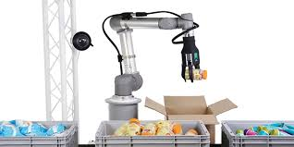
PEAS
Agent: Part-picking robot
Performance measure: Percentage of parts in correct bins
Environment: Conveyor belt with parts, bins
Actuators: Jointed arm and hand
Sensors: Camera, joint angle sensors

Slide 19
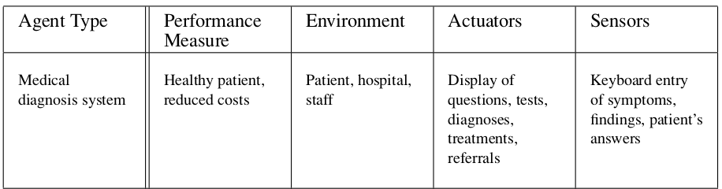
PEAS

Slide 20
Environment types
1. Observable vs Partially observable
In a fully observable environment all of the environment relevant to the action being considered is observable. A chess playing system is an example of a system that operates in a fully observable environment.
In a partially observable environment, the relevant features of the environment are only partially observable. A poker playing program is an example of a system operating in a partially observable environment.

Slide 21
Deterministic/Stochastic/Strategic
In deterministic environments, the next state of the environment is completely described by the current state and the agent’s action. Image analysis systems are examples of this kind of situation. The processed image is determined completely by the current image and the processing operations.
If an element of interference or uncertainty occurs then the environment is stochastic. Examples of this: backgammon game (because it involves throwing a dice)
If the environment state is wholly determined by the preceding state and the actions of multiple agents, then the environment is said to be strategic. Example: Chess. There are two agents, the players and the next state of the board is strategically determined by the players’ actions.

Slide 22
Episodic vs Sequential
Episodic: The agent's experience is divided into atomic "episodes" (each episode
consists of the agent perceiving and then performing a single action), and the choice of action in each episode depends only on the episode itself.
example : many classifiers
mail spam or not?
Sequential: In a sequential environment, the agent engages in a series of connected episodes.

Slide 23
Static vs Dynamic
Static Environment: does not change from one state to the next while the agent is considering its course of action. The only changes to the environment are those caused by the agent itself.
• A static environment does not change while the agent is thinking.
• The passage of time as an agent deliberates is irrelevant.
• The agent doesn’t need to observe the world during deliberation.
A Dynamic Environment changes over time independent of the actions of the agent -- and thus if an agent does not respond in a timely manner, this counts as a choice to do nothing

Slide 24
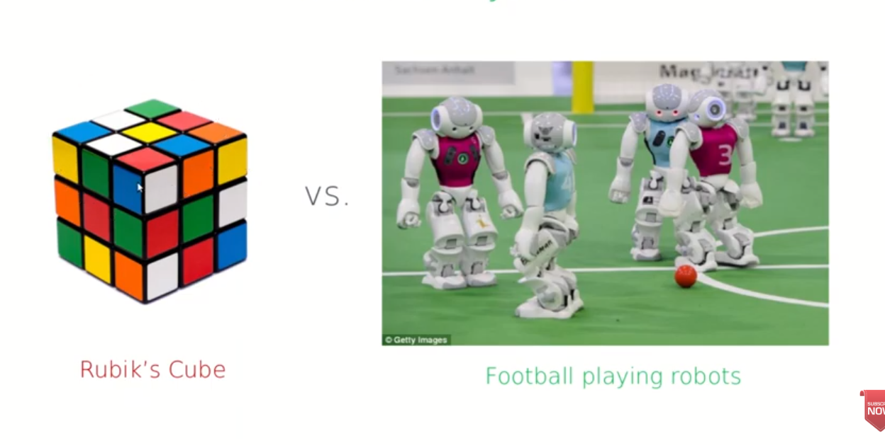
Static vs Dynamic

Slide 25
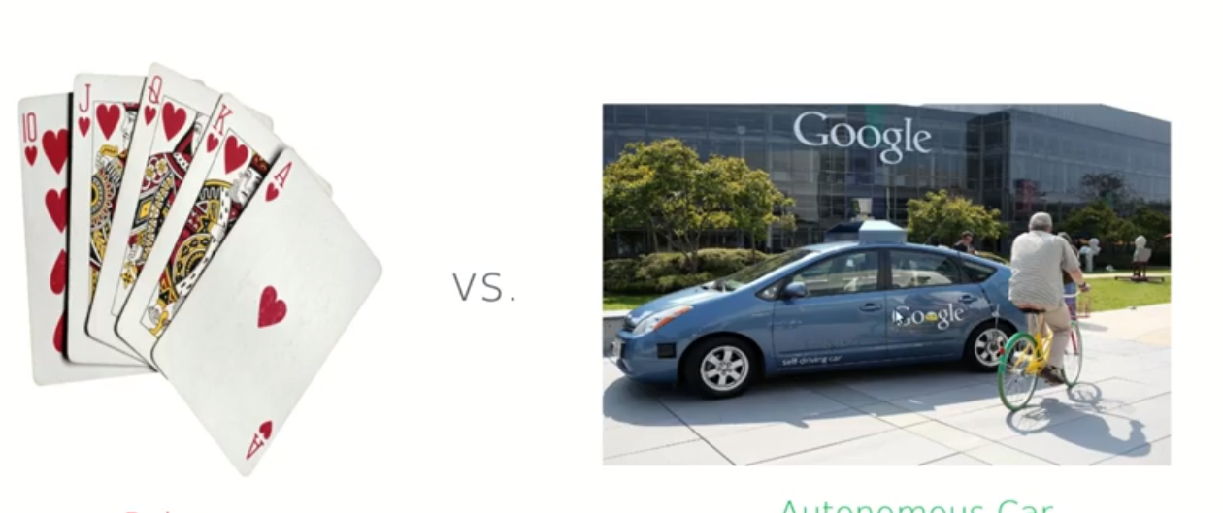
Discrete vs. continuous
Discrete (vs. continuous): A limited number of distinct, clearly defined percepts and actions.

Slide 26
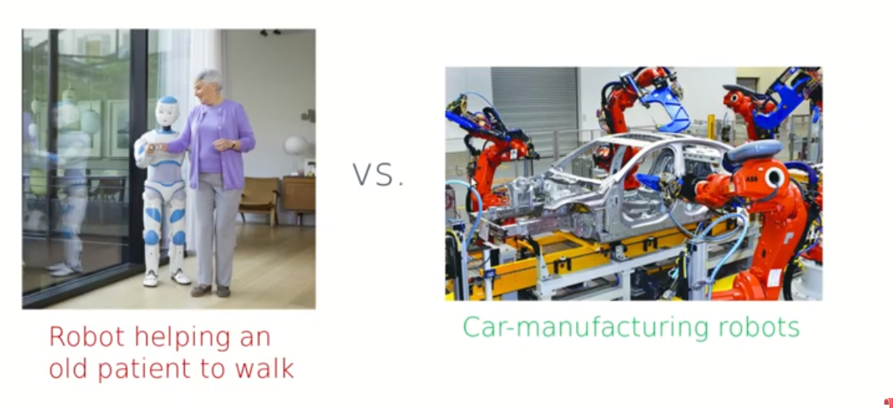
Single agent (vs. multiagent)
Single agent (vs. multiagent): An agent operating by itself in an environment whereas in multiagent we have more than one agent’s actions are important.

Slide 27
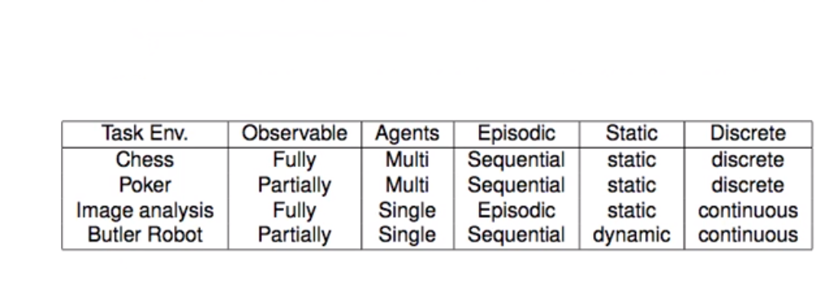
Environment types
The environment type largely determines the agent design
The real world is (of course) partially observable, stochastic, sequential, dynamic, continuous, multi-agent

Slide 28
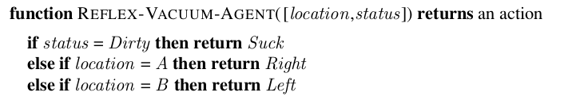
Simple Reflex Agent

Slide 29
Simple Reflex Agents
In reflex based agents,
information comes from sensors - percepts
changes the agents current state of the world
triggers actions through the effectors
Reactive agents have no notion of history. The current state is as the sensors see it right now. The action is based on the current percepts only.
The following are some of the characteristics of percept-based agents.
Efficient
No internal representation for reasoning, inference.
No strategic planning, learning.
Percept-based agents are not good for multiple, opposing, goals.

Slide 30
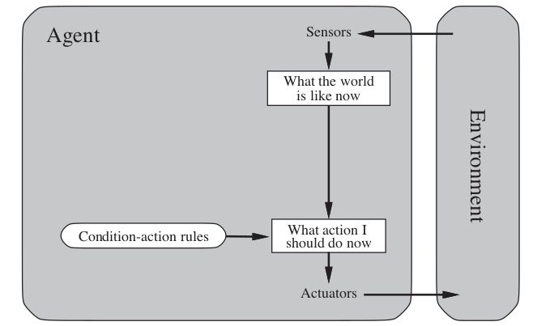
Simple Reflex Agent

Slide 31
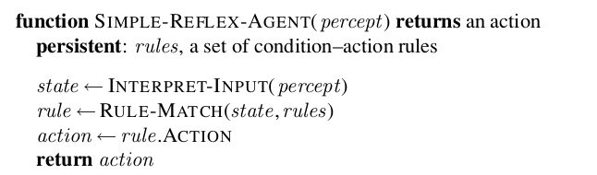
Simple Reflex Agent

Slide 32
Model based Agents
Model based agents differ from percept based agents in that such agents maintain some sort of state based on the percept sequence received so far. The state is updated regularly based on what the agent senses, and the agent’s actions. Keeping track of the state requires that:
the agent has knowledge about how the world evolves, and how the agent’s actions affect the world.
Thus a state based agent works as follows:
information comes from sensors - percepts
based on this, the agent changes the current state of the world
based on state of the world and knowledge (memory), it triggers actions through the effectors

Slide 33
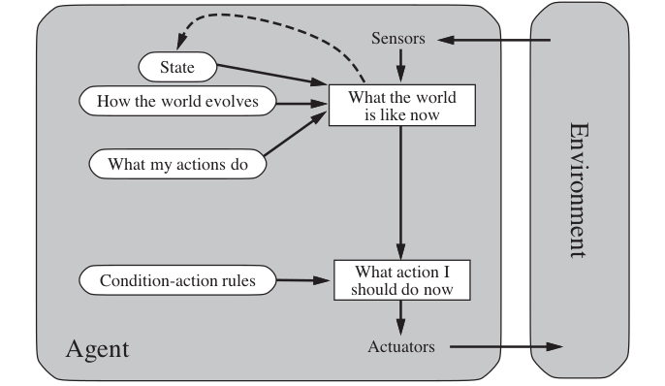
Model Based Agent

Slide 34
Goal based agent
The goal based agent has some goal which forms a basis of its actions. Such agents work as follows:
information comes from sensors - percepts
changes the agents current state of the world
based on state of the world and knowledge (memory) and goals/intentions, it chooses actions and does them through the effectors.
Goal formulation based on the current situation is a way of solving many problems and search is a universal problem solving mechanism in AI.

Slide 35
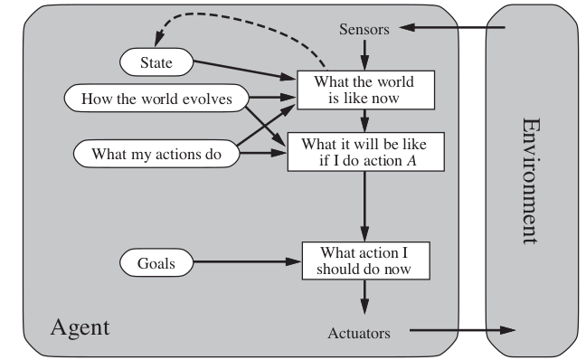
Goal based Agent

Slide 36
Utility based Agent
Utility based agents provides a more general agent framework. In case that the agent has multiple goals, this framework can accommodate different preferences for the different goals. Such systems are characterized by a utility function that maps a state or a sequence of states to a real valued utility.

Slide 37
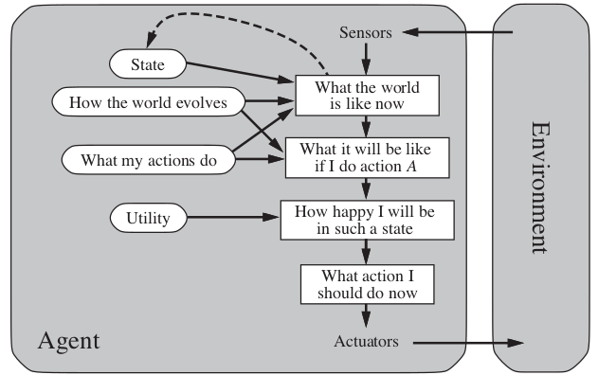
Utility based Agent

Slide 38
Learning Agent
Learning allows an agent to operate in initially unknown environments.
The learning element modifies the performance element.
Learning is required for true autonomy

Slide 39
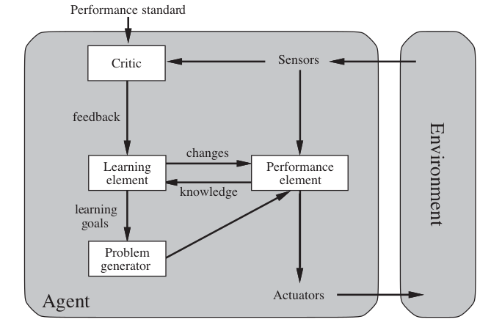
Learning based Agent

Slide 40
Thank You
Required Reading: AIMA - Chapter # 2-
Note : Some of the slides are adopted from AIMA TB materials
40
Notes:
40

